Slide 1

education caveat.
The following content has been designed and relies upon the detailed explanation provided by the presenter at the time of the seminar and should be considered in conjunction with this and not in isolation.
All copyright or other intellectual property rights in the material constituting this presentation which has been provided by Wealth at Work Limited remains the property of the Wealth at Work group of companies.
The content of this presentation is provided for illustrative purposes only and is not intended to be used for individual investment or financial planning and does not constitute financial advice.
Whilst every effort is made to ensure the accuracy of information contained in the presentation it cannot be guaranteed. In particular the rules relating to tax can frequently change. Wealth at Work Limited will not be held liable for any inaccuracies in this presentation due to a change in law after the date of delivery of this presentation.
Any references to tax or the operation of tax or tax reliefs are illustrative only and the tax treatment in respect of any individual depends upon the circumstances of each individual.
It is important to recognise that the value of investments related to the stock market (and any resulting benefits such as interest or dividends), can rise or fall and an investor may not get back the amount invested. Past performance data used is for illustrative purposes only and is not necessarily a guide to future performance.
Any hyperlinks or references to third parties or their websites are provided for information only and it does not mean that we endorse their products or services. We have no control over these and accept no legal responsibility for any content, material or information contained in them.
WEALTH at work and my wealth are trading names of Wealth at Work Limited which is authorised and regulated by the Financial Conduct Authority and part of the Wealth at Work group. Registered in England and Wales No. 05225819. Registered Office: Third floor, 5 St Paul’s Square, Liverpool L3 9SJ. Telephone calls may be recorded and monitored for training and record-keeping purposes.
Notes:
REF 347847943
PDF caveat

Slide 2


Slide 3
about us.
We are a leading financial wellbeing and retirement specialist - helping those in the workplace to improve their financial future.
Established in 2005, we work with hundreds of organisations across both the private and public sector.
Our financial education services are delivered on a bespoke basis.
341377444

Slide 4

financial education structure.
Option To Request a Callback
You will be able to ask questions relating to your own circumstances.
Online Seminar
Next steps
Today’s online seminar will cover scheme specific financial education.
We will identify your next steps and point you in the right direction.*
Notes:
point 2 on this slide has been slightly amended at the clients request.
Note this is a GSK specific slide and has a different REF number to the regular financial education structure slide.

Slide 5
what we’ll cover today.
How Share Save works
2024 Share Save invitation
Share Save maturity
Your options at maturity
How tax could apply to your gains
Diversifying your investments
Next steps

Slide 6

how share save works.

Slide 7
share save.
Save between £5 and £250 per month*
Option price is set at the start of the term and will be 20% below the share price at that time
Shares can be transferred to an ISA or SIPP
Save for a 3 year period
At the end of the term, buy shares or receive your savings back
The L&G SIPP and Equiniti ISA are available for this purpose (other providers are available)
*Note that £250 is the total maximum contribution permitted across all GSK share save plans.
Notes:
Sharesave allows you to save between £5 and £250 each month
This is intended as a medium term savings scheme, and therefore you should not save your money in this scheme if you would like access to it within the next 3 years.
There is a possible tax free bonus at the end of the contract. However you should be aware that this is stipulated by HMRC. There is no guarantee you will get a bonus.
Unlike the share reward scheme, you are not exposed to any investment risk whilst you are making savings into the scheme
This is because you are not buying share each month, but instead GSK is putting the money aside should you wish to buy the shares at the end of the term
The price you will pay for the shares, if you choose to buy them, is 80% of their value at the start of the term
At the end of the term you can choose to buy the shares at the agreed price or have your money back.
If the GSK share price at the end of the term is higher that your agreed purchase price, it is generally advisable to exercise your option to buy the shares.
This is because you will make a positive return
The return on your investment is the value of the GSK shares at the end of the 3 year period, less the agreed option price at the start of the period
If the GSK share price is below your option price it would not be advisable to exercise your option, but instead you can have all your savings returned to you
As you will have an option price that is below the share price at the start of the period, it may be possible to make a positive return on your savings, even if the share price falls slightly.
You should check your potential return before exercising any option
If you exercise the option to buy the shares at the end of the contract, you can choose to sell them immediately so you can receive your money back, plus and potential returns
Or, you could transfer the shares in the L&G SIPP or Equiniti ISA

Slide 8
share save.
Maturing Price
Opening Price
Capital Gain
20% Discount
Option Price
3 years
For illustrative purposes only

Slide 9

2024 share save invitation.

Slide 10

2024 share save invitation.
Nov
  Invitation window opened on 5 November 2024
05
Nov
  Invitation window closes on 20 November 2024
20
  The option price for Share Save 2024 is the average of the GSK share price on 31 October, 1 and 4 November 2024
  The option price for Share Save 2024 is £11.27
  Register by logging in to www.totalrewardonline.co.uk
  You will need your MUD ID and password
  Note: the £250pm contribution limit is the maximum aggregate contribution across all Share Save contracts
Notes:
GSK share closing price is used to calculate the average of the 3 day period

Slide 11
2022 and 2023 performance to date.
1521.50
Share price at close on 1 Oct 2024
2022 share save option price (1139p)
2023 share save option price (1120p)
*The share price of 1521.50 is shown for illustrative purposes only. The GSK share price may be higher or lower when you exercise your option. Share price source: google finance

Slide 12
2022 and 2023 performance to date.
01.
Share Save 2022
02.
Share Save 2023
03.
Contribution limit
04.
  Contributions you are making to either plan count towards the monthly contribution limit of £250
Matures in November 2025
Matures in November 2026

Slide 13
share save maturity.

Slide 14
share save 2021 performance.
1521.50
Share price at close on 1 Oct 2024
1207
Option Price
*The share price of 1521.50 is shown for illustrative purposes only. The GSK share price may be higher or lower when you exercise your option. Share price source: google finance
Notes:
Presenter note
The share price when an individual buys the shares will be determined by the price on that day which could be anytime within 6 months from the maturity of the plan.

Slide 15
key dates for share save maturity 2021.
Dec
Opportunity to exercise options from 1 December 2024
01
Months
You have 6 months to exercise your option
#6
Dec
11 December 2024 is the deadline for transferring GSK shares to the L&G SIPP via Total Reward Online
11
The GSK share price may be higher or lower when you exercise your option
The dates shown only apply if there have been no gaps in your 36 monthly payments.
Notes:
Presenter to note that Equiniti will get in touch with share save members in the event the GSK share price falls below the option price.
Those who missed a monthly payment will have a later maturity date.
How to transfer shares to a L&G SIPP
“Read about the L&G SIPP via GSK Help on Connect GSK.
If you wish to transfer shares to a L&G SIPP, you will firstly need to instruct to transfer your shares to the Global Nominee Service on the Equiniti ESP Portal no later than 6.00 pm, 11th December 2024 and then contact L&G personally to arrange for the transfer.
If you do not have a L&G SIPP you will also need to complete the selection process on Total Reward Online. Select ‘Benefits’ from the home page and then ‘Select Benefits’. Select ‘L&G SIPP: Apply’, ’Confirm my selection’, and follow the instructions through to ‘Finish’.”
In relation to the short time window for a transfer into the SIPP, GSK have informed us
“This is decided by L&G. The deadline is kept to early December as if receive any elections from participants who do not already have a SIPP with L&G, we need to allow enough time to ensure their new plan and stockbroker account is set up in advance of the transfer date.”

Slide 16
your options at maturity.

Slide 17
share save options at maturity.
Receive all savings back
Buy and sell
Wait up to 6 months
You may decide to do this if the share price is below the option price at maturity
Only viable if the share price rises above the option price
You have 6 months from the share save maturity to decide

Slide 18
share save options.
Buy and sell
  In the event that the share price increases above the options price…
  The proceeds will be sent by BACs to your bank account
  You will not know the GSK share price in advance
  Details of any dealing charges that apply when you sell your shares are in your share save maturity guide available on Total Reward Online

Slide 19
how tax could apply to any gains.

Slide 20


selling your shares.
Capital Gains Tax may be due when you decide to sell your GSK shares:
?
What is it?
Main Exemptions
Tax Rates
Tax on gains when certain investments (such as shares) are sold or transferred
It is only the gain that is taxed
ISAs
Transfers between spouse/civil partner
Annual exemption of £3,000 (2024/25)
Basic rate tax band: 18%
Above the basic rate tax band: 24%

Slide 21
the CGT exemption.
There may be action you can take if you expect the gains from your GSK shares to exceed your available CGT exemption.
Option 1
transfer to spouse / civil partner
Share Save member
Spouse / Civil Partner
£3,000 gain from GSK shares
No available CGT exemption due to previous share sale
No other gains to realise
Full £3,000 CGT exemption available
Option 2
use next year’s allowance
Wait until the next tax year to sell the shares –
Note: Next year’s CGT exemption and rates may change
APRIL
06
Notes:
FC to note that any gain associated with shares that are transferred to a spouse\CP becomes chargeable to the recipient when the shares are sold. If gains exceed the partner’s CGT exemption, CGT will be payable.

Slide 22





transferring shares to an ISA.
Using the ISA Transfer window (ISA allowance is £20,000 for the 2024/25 tax year)
Transferring within 90 days of the date you acquire the shares
Sell your shares immediately free of CGT, or keep them in the ISA
Shares may be transferred directly into a Stocks and Shares ISA*
Transfer is not a ‘chargeable event’ for CGT purposes
Useful if considering:
  Holding GSK shares
  Sheltering future returns from tax
  Diversifying
*Subject to ISA limits. The Equiniti ISA is available for this purpose however you can choose an alternative provider

Slide 23

diversifying your investments.

Slide 24
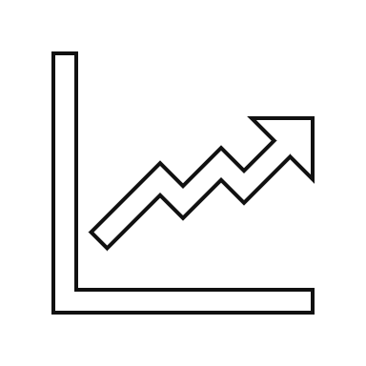



investment risk and returns.
High
Equities
    Volatility, Timing, Concentration
Property
    Liquidity, Negative Equity, Taxation, Tenants
Bonds
    Default, Credit, Inflation
Cash
    Inflation, Interest Rates, Currency Exposure
Low
911901396

Slide 25







diversification.
01.
Single
02.
Many
03.
Many
04.
Geographical
Company
Companies
Sectors
Areas
Diversify further by ensuring investments are in different sectors
Finally, spread investments across economies throughout the world
Exposure to the fortunes of a single company
Invest in a number of companies
Future wealth aligned to the success of a single company
Limits exposure to a single company
Limits exposure to a single sector (e.g. retail)
Limits exposure to a single country or region
128804912
Notes:
2

Slide 26
diversification.
As well as diversifying within equities, you could also look to diversify in the assets you hold.
Which assets should you buy?
Bonds
What proportion of each do you need?
Property
Equity
Other
How do you know when to buy and sell?
Cash
866400430
Notes:
866400430
Presenter notes:
Use this slide to talk about diversification within your portfolio. Eg – shares, bonds, property, cash and some of the questions you need to ask yourself when putting together a portfolio.
This will then lead on to the next few slides explaining how diversified investments can help.

Slide 27




types of investments.
Whichever assets you choose to invest into (e.g. equities, property or bonds) you can either invest directly or via a ‘fund’.
For example, if you were considering an equity investment:
Invest directly into shares in one or more companies
OR
Invest into a fund that tracks a number of indices
(e.g. FTSE 100, S&P 500 and EURO Stoxx 50)
Invest into a fund where active decisions are made on which companies to buy and sell
OR
OR
Invest into a fund that tracks an index
(e.g. FTSE 100)
906134340

Slide 28




how can you invest?
There are a number of different places you can go to set up an investment account. These include:
Financial Adviser
Provides advice & can transact on your behalf and provide regular reviews
Online Investment Platforms
Online accounts or apps allowing you to hold many investment types in one place
Insurance Companies
Some well known insurance companies offer online investment accounts
High Street Banks
Stockbroking services offered by high street banks
Within each of these services you can often access ‘tax wrappers’ such as an ISA or SIPP
1535413

Slide 29

next steps.

Slide 30
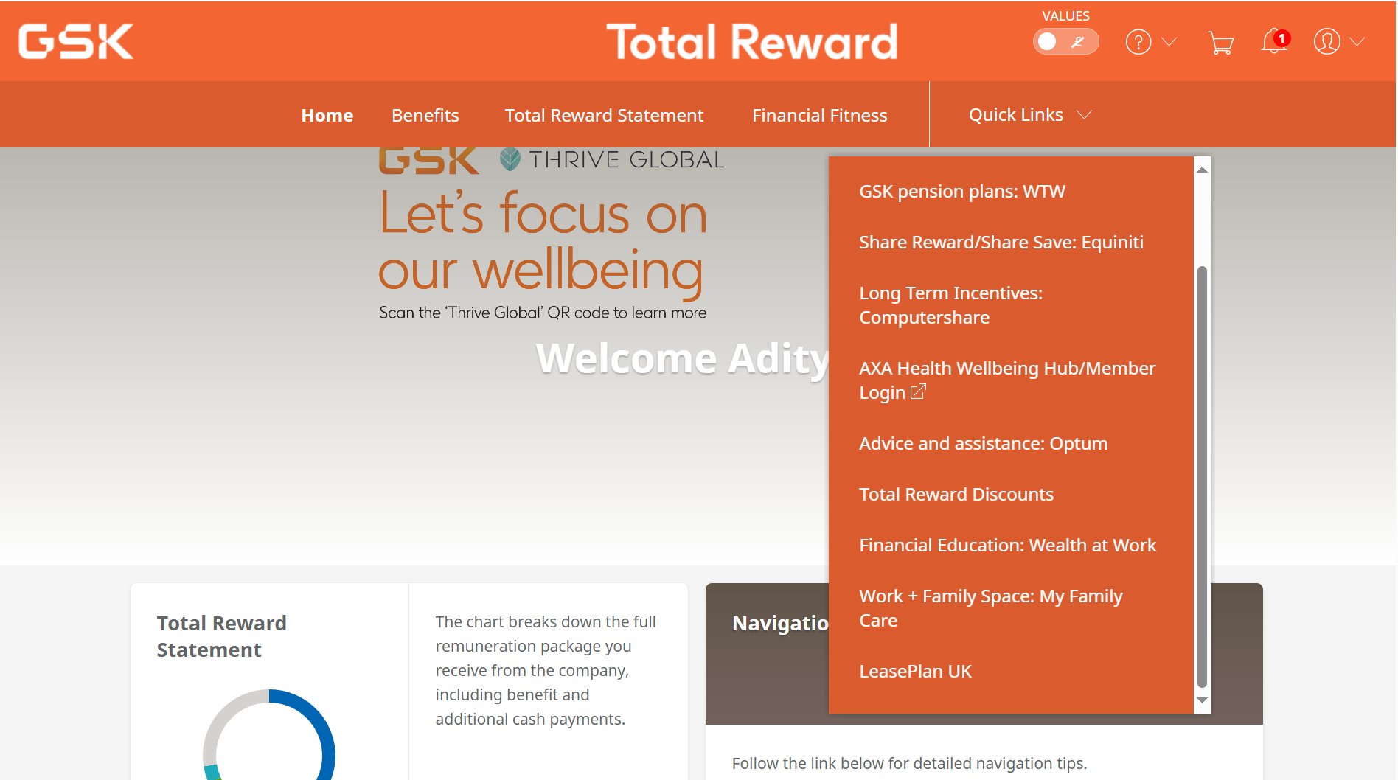
further information and guidance.
Notes:
REF 320837324

Slide 31
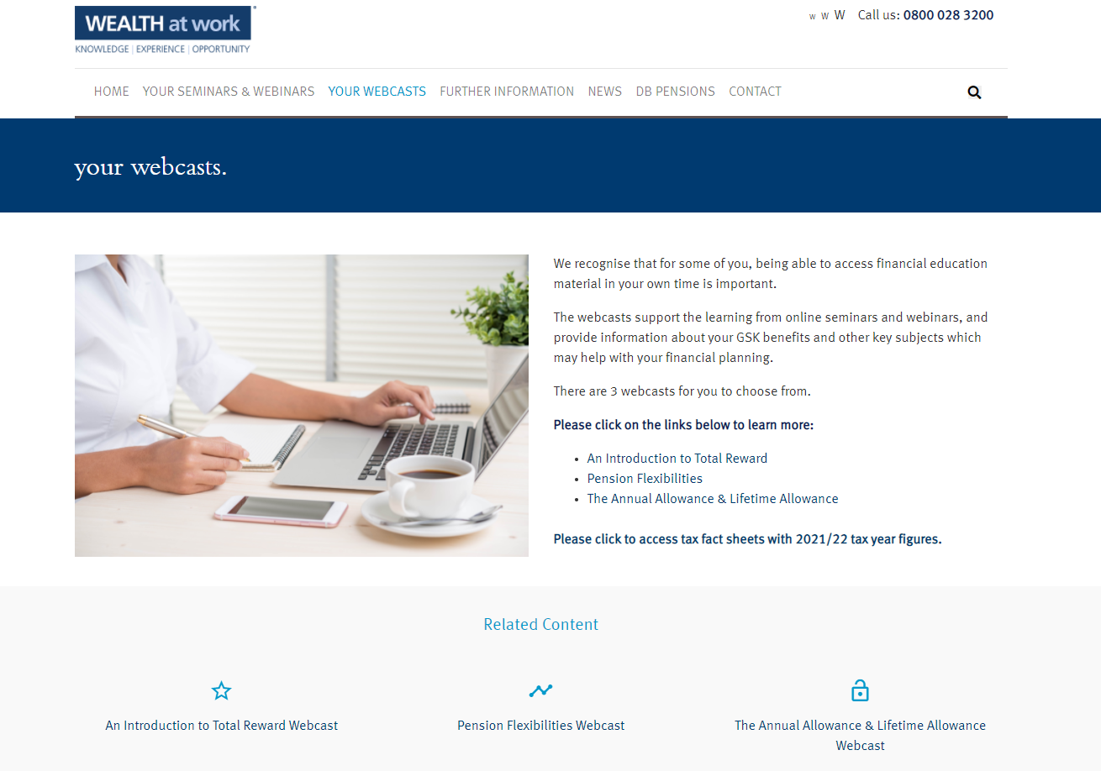
your webcasts.
Notes:
REF 227865566

Slide 32
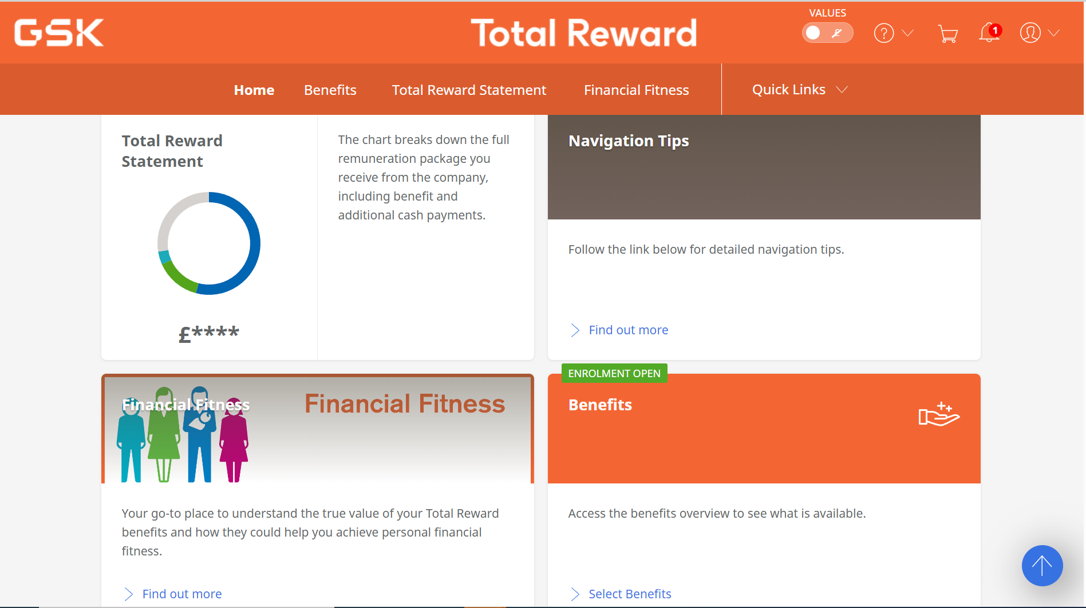
further information and guidance.
  The Financial Fitness Hub is also available from Total Reward online. Clicking on the “Financial Fitness” tile will take you through to the Financial Fitness Hub.
Notes:
REF 332315356

Slide 33
further information.
Total Reward information on Connect GSK
Provides general information about how the Total Reward plans work.
Go to the UK HR page on Connect GSK.
Total Reward Online
The home of your personalised Total Reward information, where you enrol or make any changes to your Total Reward and can link to benefit administrator websites including WEALTH at work for financial education.
Go to www.totalrewardonline.co.uk from work or home using your MUD ID and password.
Questions About Your Total Reward Benefits
For any questions about your Total Reward, please contact ServiceNow
Join the UK Benefits Workplace group to keep up to date with news and information.
Notes:
REF 571821663

Slide 34
further information and advice.
Personal budgeting and setting goals
www.moneyhelper.org.uk
State Pensions, Income Tax and ISAs
www.gov.uk
www.hmrc.gov.uk
Financial Advice
Your existing adviser, Origen, Chase de Vere, my wealth
Notes:
REF 84428123

Slide 35
seeking regulated financial advice.
Please note, this session provides education and information only and does not include or constitute financial advice.
GSK has undertaken due diligence on Wealth at Work Limited in the provision of education and guidance services only. Wealth at Work Limited (trading as ‘my wealth’) offers regulated investment advice. GSK recommends that if you need regulated financial advice, such advice is available from a range of sources, details of which are available from the financial conduct authority at www.fca.org.uk. GSK is not endorsing nor has undertaken due diligence on Wealth at Work Limited (trading as ‘my wealth’) for the provision of regulated financial advice.
Wealth at Work Limited trades as both ‘my wealth’ (when providing guidance and investment advice) and ‘WEALTH at work’ (when providing education).

Slide 36
thank you.
0800 028 3200
www.wealthatwork.co.uk/mywealth
156297902

